Slide 1

Downloading Library E-Books
Christina Chan, Science Librarian, Baylor University
Notes:
Introduce myself. I’ve been the Science Librarian at Baylor for 1.5 years and currently a UNT student. Before coming to Baylor I did my post-doc in Geophysics at Ohio State and taught and ran an NSF program at UH. The title of my talk is not exactly what’s on the agenda because Beth wanted me to present something on e-books rather than what I first proposed so I texted her the title late Wednesday night probably after she already printed up the agenda. Of the reference librarians I probably know the most about our academic library ebooks. Other librarians have had e-readers longer, but that was more for personal use. I got rather frustrated because no one had a definitive answer about downloading e-books and the electronics library librarian kept on saying she’d write a libguide, but didn’t. I also got a nook for my birthday this year so I decided once spring semester was over I would investigate what was possible.

Slide 2
Notes:
If your library is like ours, you are getting this question more and more often
Our answer used to be “no, you can’t.” But now it’s “it depends.” And it depends on a lot of factors.

Slide 3

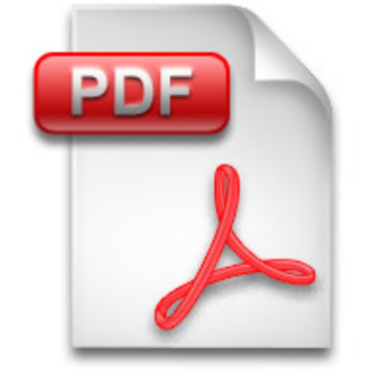
Format
Notes:
It depends on the format of the book. All of you are familiar with pdf. You might be less familiar with ePub. ePub is a form that repaginates the book when you change the font size or type, you can change background color so you can use light font on dark at night. You can find ePub readers for iOS, Android, Blackberry, even web browsers. Kindle uses another DRM form: Mobi.

Slide 4
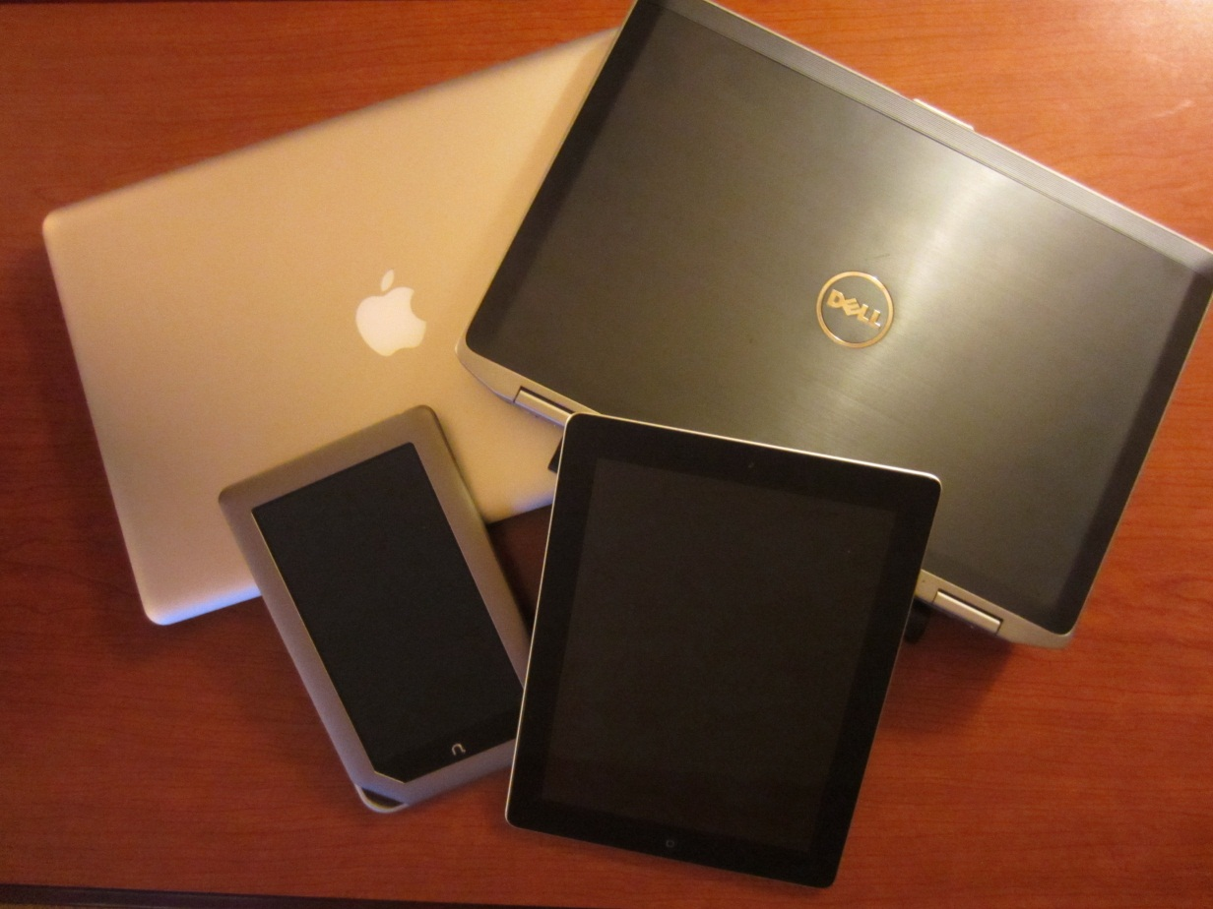
Device
Notes:
So whether you can download also depends on the device you want to download to. A computer or an e-reader or iPad or tablet. Possibly a phone, but most people probably don’t want to read on something so long on that small a screen. A year or two ago it was more for computer downloads. Since Christmas last year it’s been primarily e-reader downloads.

Slide 5
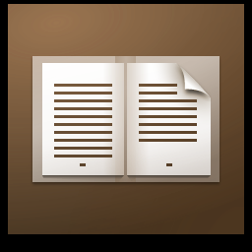

Digital Rights Management
Notes:
So most of you are probably familiar with DRM. Basically DRM limits copying, printing, or sharing of e-books since it is the library and not the reader that owns the book. Since many of the books that are our patrons want to download have DRM, you need to use a reader that is DRM compatible. First, you need Adobe Digital Editions. For e-readers, the native reader will work and for tablets/phone, you also will need BlueFire Reader unless you an app from a provider. There is a list of apps that can read DRM. There’s a handful of iOS and Android apps. Maybe 2 or 3 PC desktop apps, and I didn’t see any Mac desktop apps.

Slide 6

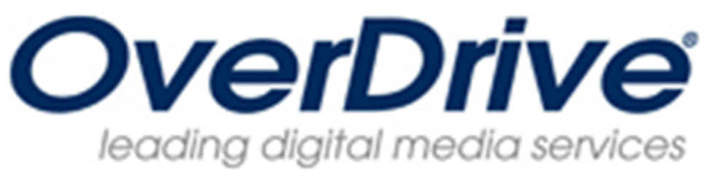









Publisher/Provider
Notes:
Overdrive: ePubs, kindle compatible, uses DRM
Ebsco: not all books downloadable, currently DRM pdfs, plans to convert to ePub and to build an app
Ebrary: DRM pdfs, has an iOS and Android app that only reads DRM pdfs, not all books downloadable, but 1 chapter or 60 page non-DRM pdf limit.
myiLibrary: DRM pdfs
Safari: iPhone/iPad app that allows one book download at a time
EBL: we don’t have EBL but from what I can tell they have DRM pdfs
Knovel: has downloadable pdfs, but much of the material is interactive and doesn’t really make sense by itself
Springer, Elsevier: no DRM pdfs
Wiley-Blackwell: I’m not positive, but chapters are non-DRM pdfs

Slide 7
How to Download to your Computer
Download Adobe Digital Editions
  Sign into your Adobe account
Find your book in Ebrary or EbscoBooks
  Sign into your Ebrary or Ebsco account
Click on Download
Open the download in Adobe Digital Editions
Notes:
So, if it’s non-DRM pdf, you can read it anywhere.
If, it’s non-DRM epub (not common in academic libraries), you can read it with any Epub reader.
If, it’s DRM you have to do it this way.
It’s very similar to what you would do with Overdrive if you’ve used it at a public library.
Ebrary book: Scientific English xinachan std
Ebsco book: Scientific Writing cy_chan@baylor.edu SUstd
You can read it using ADE on your computer. ePubs won’t have the cool features, but probably not as necessary if reading it on a big screen.
On my mac, it didn’t open up immediately in digital editions and I had to move the book to the digital editions folder, but I think it has to do with the way I have my preferences set up in my web browser

Slide 8
How to Transfer to an E-reader
Connect E-Reader to computer
Open up Adobe Digital Editions
Drag book to E-Reader library
Disconnect E-Reader
Open E-book in E-Reader
  Library→My Stuff→My Nook→Digital Editions
Notes:
The location might be different with different e-readers.

Slide 9
How to Sideload to an iPad
Pair your iPad with your computer
Open up iTunes
Click on your iPad under Devices
Goto the Apps menu at the top
Scroll down to the bottom of the page
Click on the App you would like to use to read
Click Add
Navigate to the e-book you want to sideload
Open e-book in your app
Notes:
Bluefire can read both pdf and epub
Ebrary can read epub but won’t have the fancy features

Slide 10
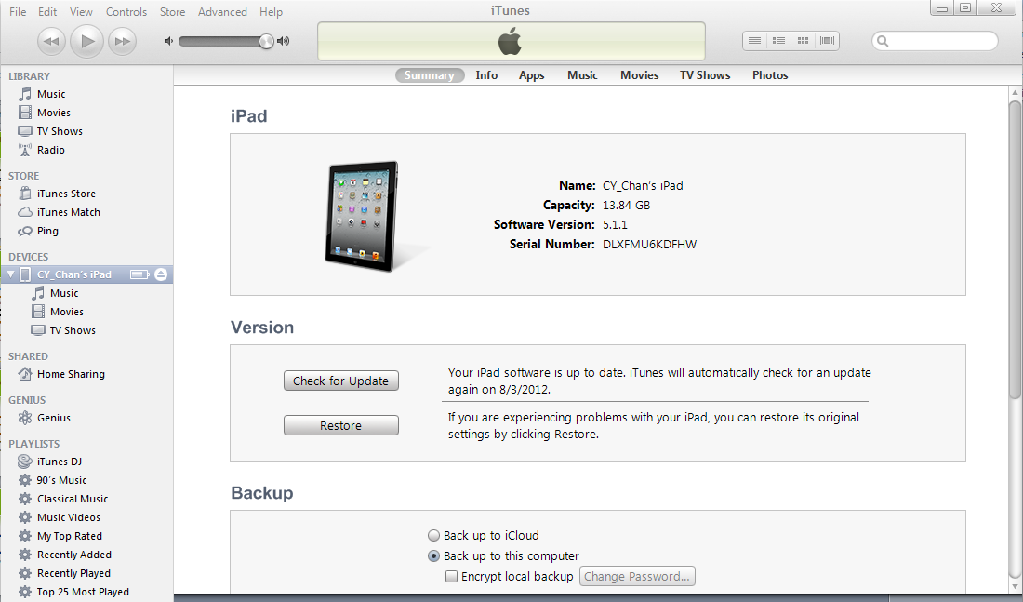

Slide 11
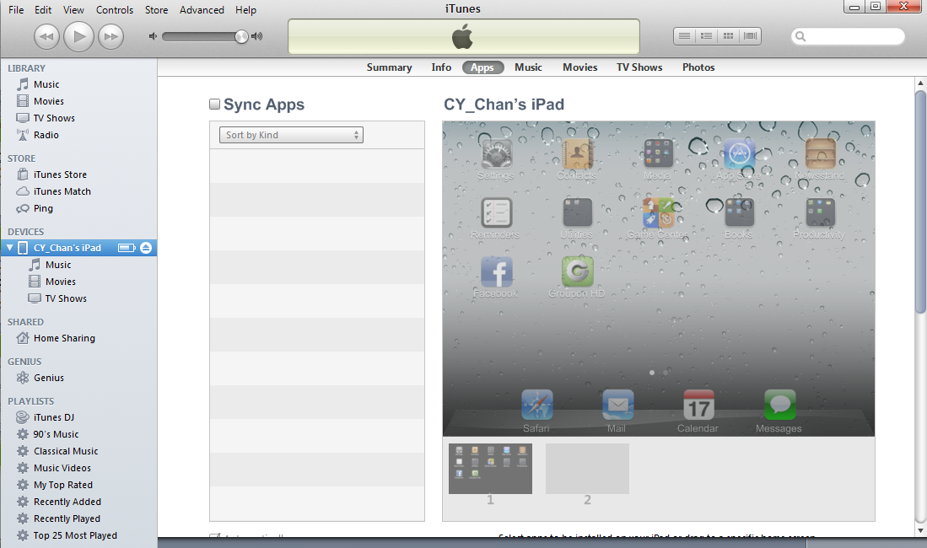

Slide 12
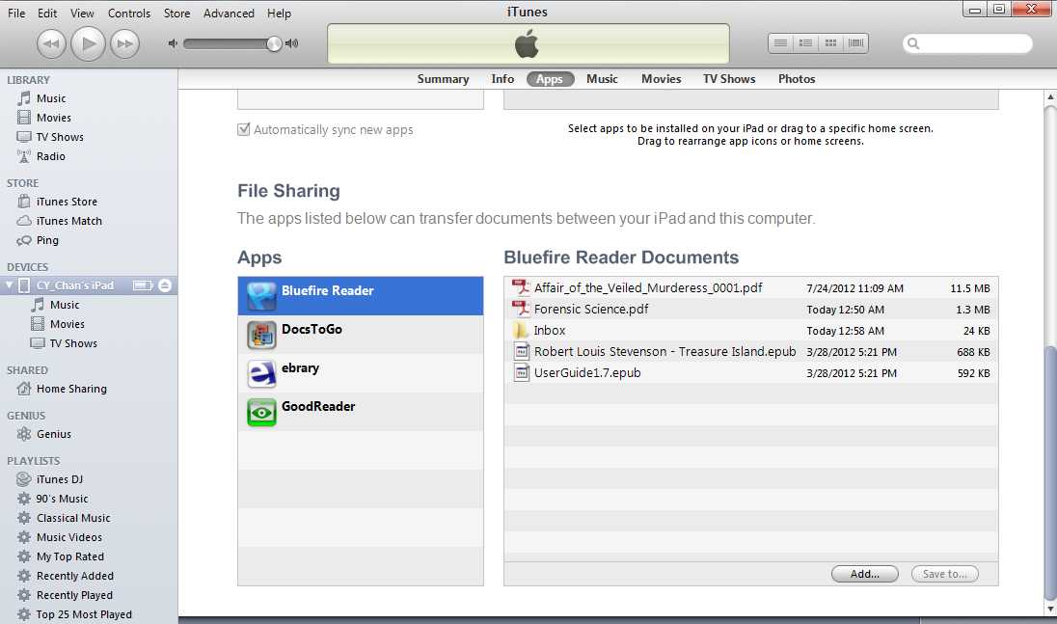

Slide 13
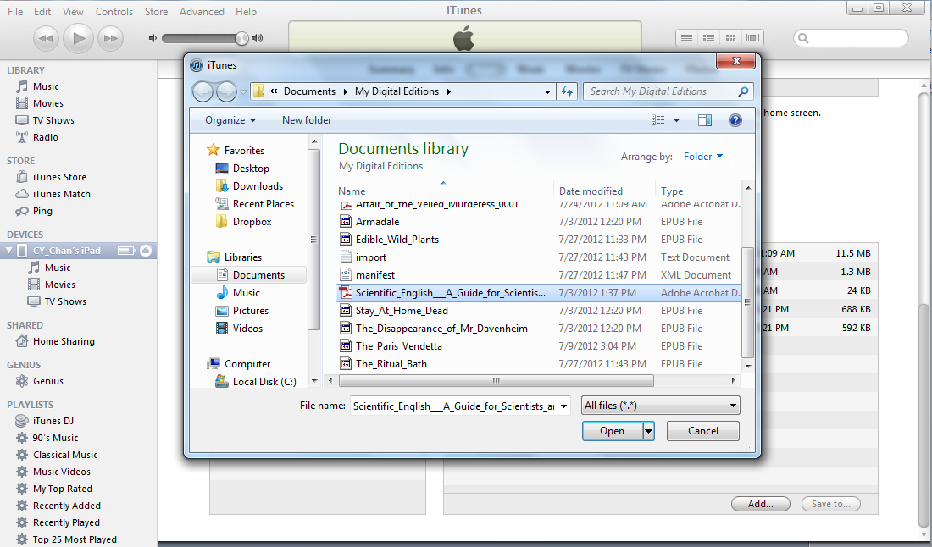

Slide 14
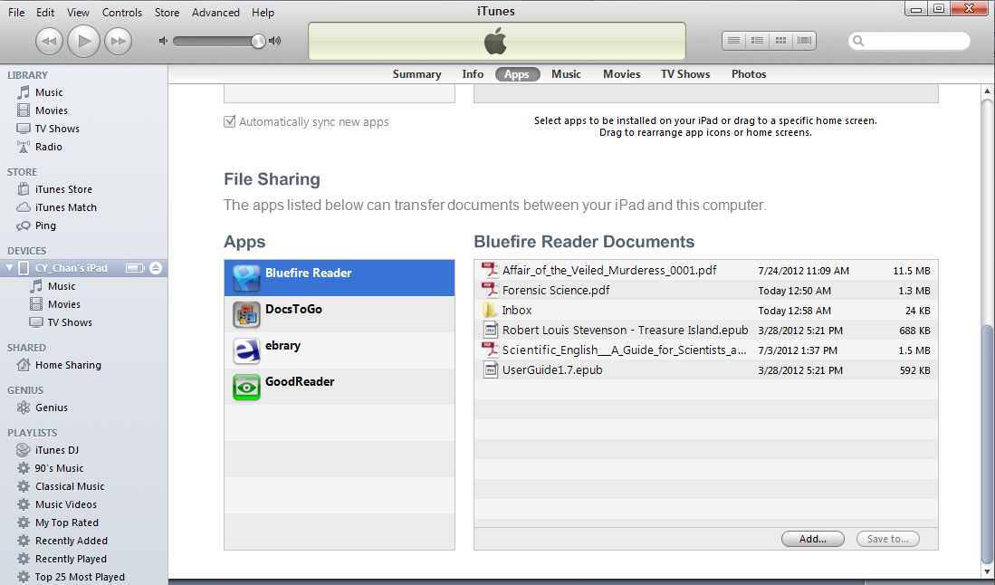

Slide 15
Other iPad Info
Ebrary App
  Associates you with library
  Can search and download directly
  Can also read sideloaded books
Download using Safari from library website
  Can choose what reader to use
Notes:
Ebrary books many not downloadable. Default is to not have single user purchase books downloadable.
Why bother with sideloading if you can download to your computer.
Most people do library searches on a computer and not an iPad. Also in Ebsco and Ebrary maybe too (don’t get as many complaints about it), sometimes if you open it on your computer the time-out to put the book back on the shelf (even if you’ve closed it) can be really long so you can’t access it on your iPad.

Slide 16
Not Covered
Safari
  Can only read Safari books
Over Drive
  E-Reader and computer the same
  App allows you to search a library and directly download
Android apps
Notes:
Things I haven’t tried.

